Slide 1

Human resources slide 1
Employee satisfaction and attrition analysis for Atlas Lab
Raghad Al-Allan

Slide 2
Human resources slide 2
AGENDA
Problem Statement And Data Collecting
Data Profiling And Curation
Exploratory Data Analysis
Visualization And Dashboards
Conclusion And Takeaways

Slide 3

Human resources slide 3
Data Collection:
Problem Statement:
Employee performance, satisfaction, and retention are crucial factors for organizational success. High attrition rates can be costly, and a disengaged workforce can lead to decreased productivity. This project aims to analyze employee data from Atlas Labs to identify key drivers of performance, satisfaction, and attrition.
Business Impact: This analysis will uncover valuable insights into the relationships between employee characteristics, salaries and job satisfaction, with a primary focus on attrition rates.
Expected Outcomes:
Actionable insights into the factors influencing employee performance, satisfaction, and attrition.
Identification of key demographic trends related to employee well-being and engagement.
Recommendations for optimizing HR strategies to improve employee retention and overall organizational outcomes.
HR Analytics Employee Attrition & Performance.
Source : Kaggle - Dataset Link
Dataset Info:
12.9%.
The dataset contains two parts (CSV Files):
Employee: Information about employees, including demographics, job details, work history, and attrition status.
PerformanceRating: Performance review data, including ratings on various aspects of work-life, satisfaction, training, and self/manager assessments.
California Turnover Rate
Dataset Limitations:
This analysis is based on a static dataset and does not account for changes in employee behavior or organizational context over time.
The project focuses specifically on the relationships between demographics, performance ratings, job satisfaction, training, and attrition. Other potential influences on these factors are not considered.
Incomplete Performance Data: Not all employees have corresponding performance review data.
The state experiences one of the highest employee turnover rates in the nation. (MaisonLaw)

Slide 4

Developing this project has been a process of exploration and refinement. It started with questions—some found clear answers, while others remained unresolved. Along the way, some things I thought would provide valuable insights turned out to be less useful than expected, while unexpected patterns emerged and shaped the analysis in new ways. Every step brought something to consider, reinforcing that data analysis isn’t just about finding answers but about learning, adapting, and uncovering new perspectives.
Important Note

Slide 5

Human resources slide 9
Data Profiling And Curation
Queries were run to inspect the database schema, check metadata, and count the number of rows in each table.
SQL queries were used to check for missing values in all columns of both tables.
Cleaning up the EducationField column: When looking at the different values of education fields (using Distinct () function), it was noticed that "Marketing" appeared two times. To check if this was due to extra spaces, the TRIM () function was used. This showed that the duplicates were indeed caused by extra spaces in some "Marketing" entries. To fix this, the TRIM () and Update functions was used to remove all extra spaces from every entry in the EducationField column. This made the data cleaner and more consistent.
Data Type Adjustments: After checking the data types for all columns, it was found that the ReviewDate column in the Performance table was stored as text. To enable date-based analysis, this column was converted to a standard 'YYYY-MM-DD' date format using a Python script. The converted dates are stored in a new FormattedDate column with a DATE data type.

Slide 6
Human resources slide 9
Exploratory Data Analysis
Employee Distribution: In this section, I analyzed the distribution of employees who are still with the company, excluding those who have left. This analysis helps me understand the current workforce and its distribution across various categories. It’s important because focusing on active employees gives us a clearer picture of factors like job satisfaction, performance, and potential for improvement in retention strategies.
I used various visualizations, including pie and bar charts, to analyze the distribution of employees across different categories such as gender, age, ethnicity, education level, department, and years at the company. These charts provided clear insights into the composition of the workforce and allowed me to explore key patterns. For example, I observed that the workforce is predominantly young, with the largest age group being 18-30 years. In terms of education, most employees hold a Bachelor's degree, and the company has a strong representation in the technology department. Additionally, the majority of employees have been with the company for 6-10 years, suggesting good mid-career retention.
However, there were some categories I chose not to explore in detail. For instance, I didn't delve into the "JobRole" category, as it didn't add significant value for this analysis. Additionally, the marital status category was considered but ultimately not included in the report due to its lesser relevance to the main focus on employee demographics.

Slide 7
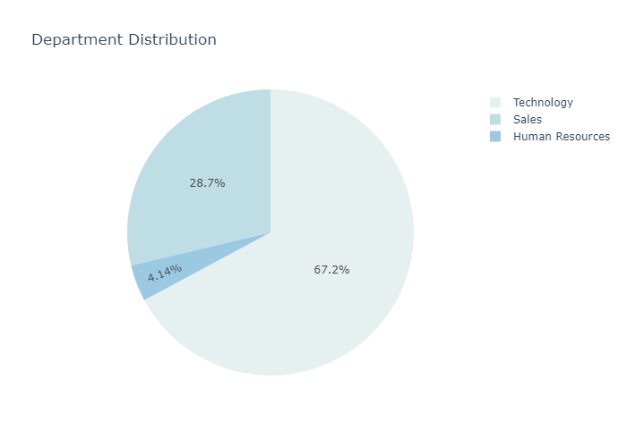
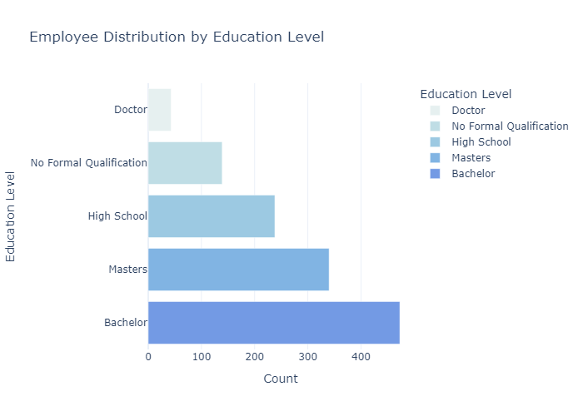
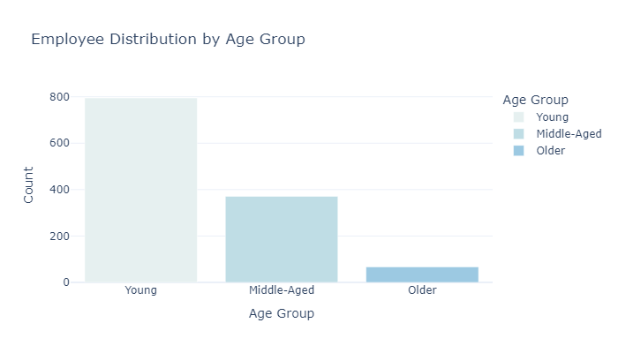
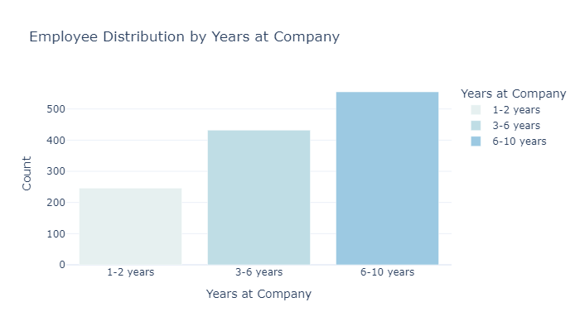
Human resources slide 9

Slide 8
Human resources slide 9
Exploratory Data Analysis
• Salary Analysis: This section provides a detailed analysis of employee salaries, examining salary distributions and key relationships with job roles, departments, job satisfaction level, some demographics and work history. The aim was to understand salary trends, identify disparities, and look for patterns based on various factors.
The salary analysis showed a broad range of employee salaries, with a positive skew indicating that most employees earn mid-range salaries, while only a few earn significantly higher wages. Job satisfaction was found to correlate with salary, as employees with higher satisfaction levels tended to earn more. Overtime workers also earned higher salaries on average, and higher education levels were associated with higher pay, with those holding Doctorates earning the most. The gender comparison showed that female employees earned slightly more on average than male employees, while non-binary employees earned a bit less.
However, I initially tried to compare these average salaries to the California industry averages, the vast number of influencing factors made this comparison less useful, so I discarded it. Also, I analyzed salary distribution by ethnicity and age group to explore potential disparities or trends ,but this analysis was ultimately discarded to maintain neutrality and avoid speculative conclusions without further supporting data.

Slide 9
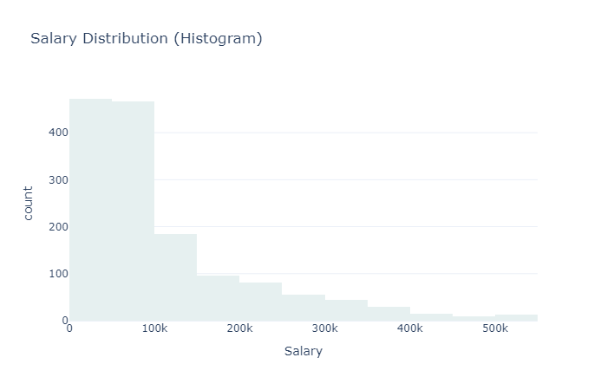
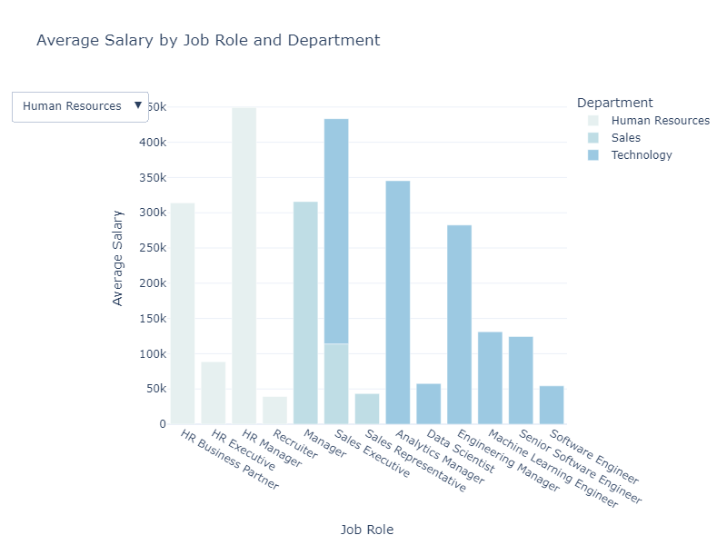
Human resources slide 9

Slide 10
Human resources slide 9
Exploratory Data Analysis
Attrition :In this section, I analyzed employee attrition rates across different factors, including department, age group, job satisfaction, relationship satisfaction, environment satisfaction, and work-life balance. This analysis provides insights into where the company is experiencing higher turnover and offers potential areas for improvement in retention strategies. The analysis revealed key trends that provide insights into areas with higher turnover and where improvements in retention strategies could be made. Sales and HR departments have the highest attrition rates at 20.62% and 19.04%, respectively. Younger employees (under 30) show a significantly higher attrition rate (20.42%) compared to older age groups, highlighting the possibility of younger employees seeking other career opportunities or facing challenges in their roles. I also found a clear connection between lower job satisfaction and higher attrition, with the highest attrition rate of 26.3% observed among employees with the lowest job satisfaction. Similarly, employees with low relationship satisfaction (29.35% attrition rate) and poor work-life balance (32.1% attrition rate) were more likely to leave, indicating that improving work relationships and work-life balance could help improve retention. These findings offer actionable insights for the company to target specific areas, such as employee satisfaction, work-life balance, and job satisfaction, to reduce turnover and enhance employee retention. While I considered analyzing a few additional factors, I decided not to include them in the final analysis. For example, I looked at the idea of comparing salary distribution by ethnicity and age, but I felt it could lead to biased conclusions and wasn't necessary for this analysis. I also explored the impact of managerial ratings on attrition but found it difficult to connect with the available data, so I left it out.
Employee Attrition Risk Prediction: In this part, I focused on predicting the risk of employee attrition based on key factors such as Age, Job Satisfaction, Relationship Satisfaction, and Work-Life Balance. By building a simple classification model, employees were grouped into two categories: High Risk and Low-Middle Risk. This approach allowed me to identify which employees were at a higher risk of leaving the company, enabling the company to take proactive steps to improve retention. Initially, more complex models, like Decision Trees, were explored for prediction. However, due to their complexity and challenges in implementation, a simpler approach was chosen for practical and actionable insights.

Slide 11
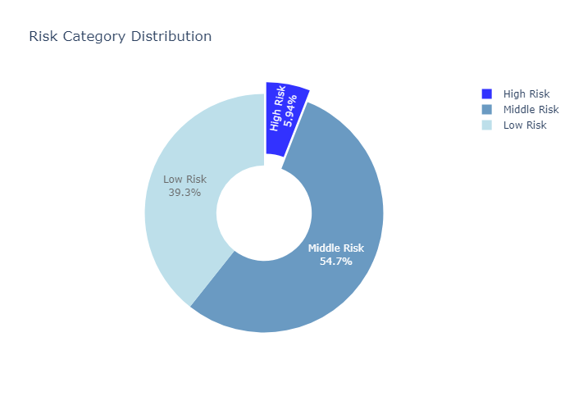
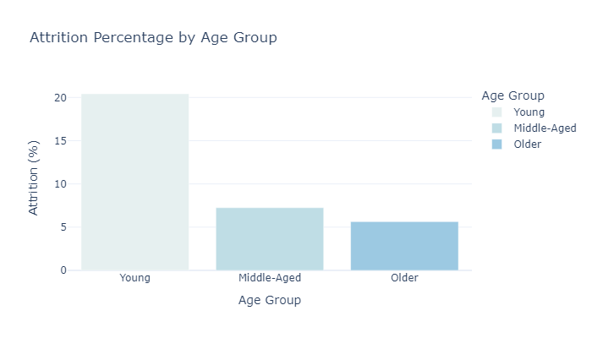
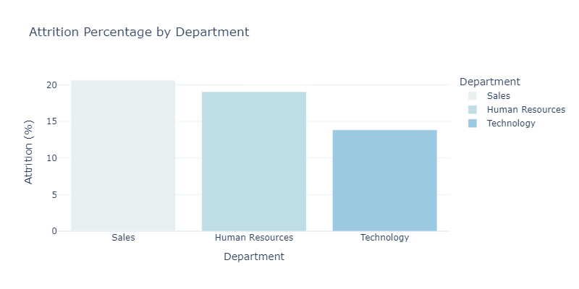
Human resources slide 9

Slide 12
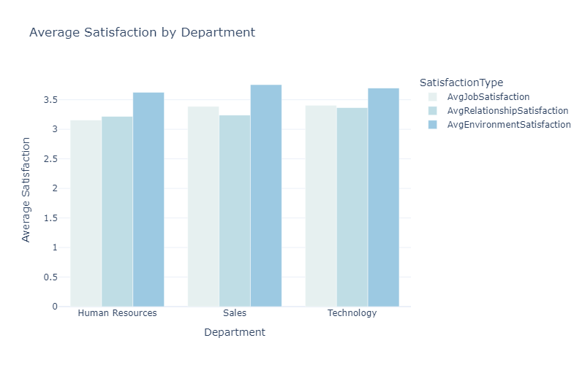
Human resources slide 9
Exploratory Data Analysis
Average Satisfaction Levels across Departments: In this section, I analyzed the average satisfaction levels across various departments for environment satisfaction, job satisfaction, and relationship satisfaction. The analysis shows that employees across all departments report high satisfaction with their work environment, with scores ranging from 3.741 to 3.819. However, job satisfaction in human resources stands out as particularly low, with an average score of just 3.1. This could be due to the stressful nature of HR work, dealing with complaints, conflicts, and a lack of recognition. For relationship satisfaction, the sales department had the lowest score, which could be attributed to the high-pressure, competitive nature of the sales environment, leading to tension among team members. (Colab Notebook)

Slide 13

Human resources slide 7
Important KPIs
16.12%
1233
53
118856.4
Attrition Rate
Current Active Employees
Employees At
High Risk Of Attrition
Average Salary
Attrition is higher among new employees (1-2 years)
Indication of large company size
With 488 employees at middle risk
With broad range of employee salaries

Slide 14
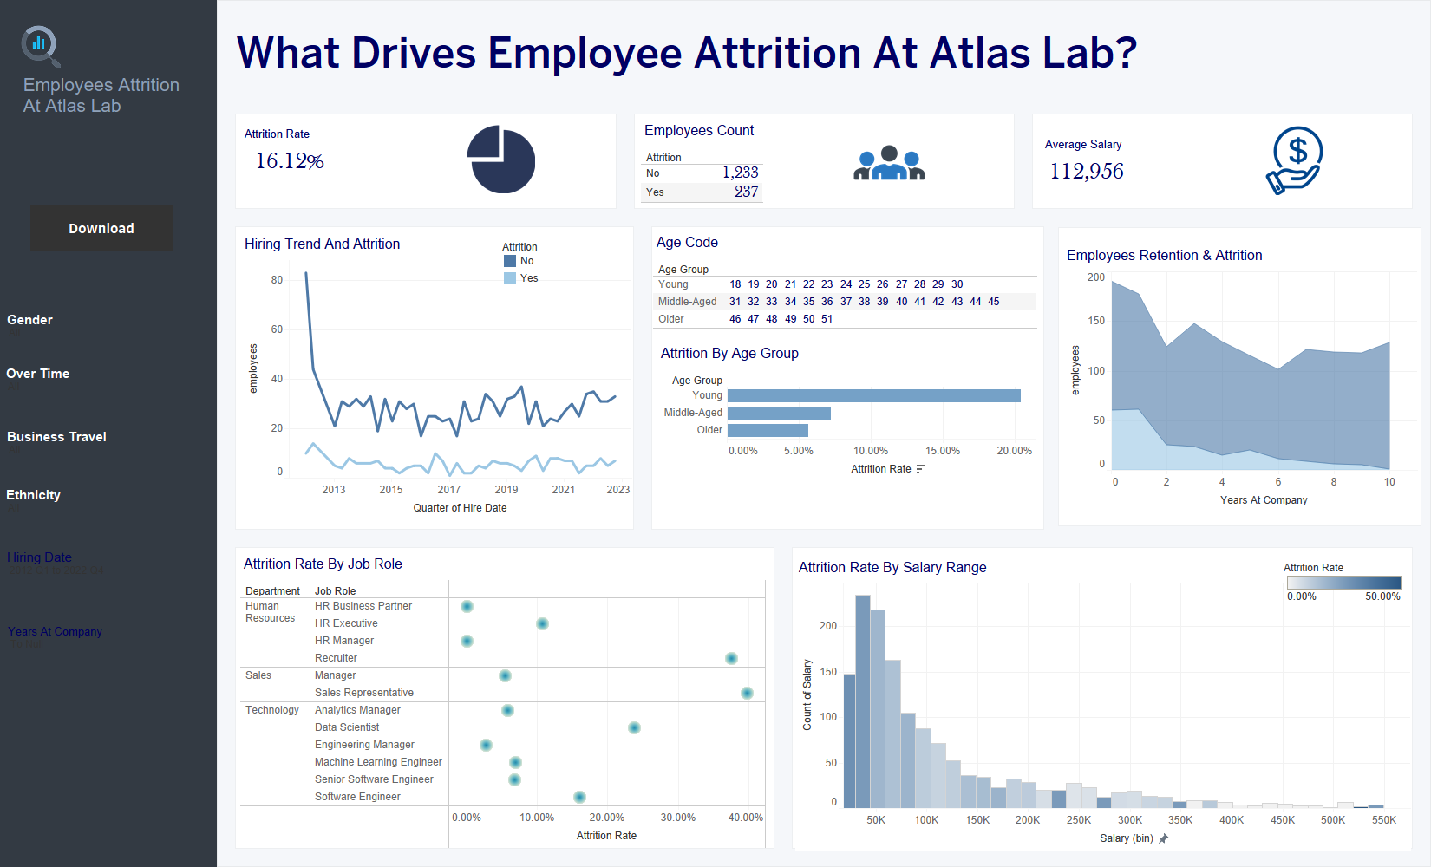

Slide 15
Human resources slide 4
What Next?
Suggested Human Resources Strategies
Retention Programs:
Job Satisfaction:
Improve engagement through feedback, recognition, and rewards
Address attrition drivers with career growth, better pay, and mentorship
Data – Driven HR :
Competitive Pay & Benefits:
Use analytics to monitor trends and predict attrition
Adjust salaries and offer flexible work options
HUMAN RESOURCES

Slide 16
Human resources slide 10
Thank You

